Slide 1


GPT AI Solution for UAT Test Data Mining
Streamline UAT testing with an AI-powered solution for efficient test data retrieval.
by Rahul Abhyankar

Slide 2

Problem Statement
1
Data Access Challenges
Identifying and retrieving test data across multiple databases is a complex task, requiring significant manual effort.
2
Regression Testing Delays
Manual data mining processes significantly impact the timely execution of regression tests for monthly releases.
3
Overburdened Test Data Team
A single resource handling all test data requests leads to a high workload and potential delays in meeting testing demands.
4
Data Location Difficulty
Locating relevant test data across numerous databases becomes a challenge, hindering efficient test execution.

Slide 3
Impact
Testing Efficiency
Project Delivery
Team Pressure
Manual data mining significantly slows down the testing process, impacting overall project timelines.
Delayed test execution leads to a ripple effect on project delivery, impacting deadlines and client satisfaction.
The reliance on a single resource for test data management creates significant pressure and workload, leading to potential burnout.

Slide 4

Proposed Solution
Automated Data Mining
Leverage a GPT AI solution to automate the retrieval of test data, significantly reducing manual effort.
User-Friendly Interface
Provide a user-friendly interface where users can easily input their test data requirements in natural language.
Natural Language Processing
Utilize NLP capabilities to translate natural language requirements into SQL queries, eliminating the need for manual coding.
Human-Readable Results
Present the retrieved data in a human-readable format, using NLP for clarity and easy interpretation.

Slide 5

Approach
1
Integration
Integrate the GPT AI solution with existing UAT environment databases, ensuring seamless access to test data.
2
Interface Development
Develop a user-friendly interface for test data requests, enabling users to input their requirements effectively.
3
Model Training
Train the GPT AI model to convert natural language inputs into accurate and efficient SQL queries for data retrieval.
4
Result Presentation
Present the retrieved test data in a tabular or desired format, facilitating easy analysis and interpretation by users.

Slide 6

Technology Stack
Programming Language
Python
LLM Models
GPT (OpenAI) or LLAMA (open-source alternative)
Frameworks
LangChain for chaining queries
Databases
P1, One Source, DMS, GAMS, SDP, In-View, MS-BF
Development Tools
VS Code, SQL databases

Slide 7





Benefits
Time Savings
Significantly reduce the time required for mining test data, leading to faster testing cycles.
Efficiency Enhancement
Improve efficiency for both testers and data teams, allowing them to focus on core tasks.
Scalability
Provide a scalable solution that can be implemented across multiple projects within CITI, expanding its impact.
Continuous Improvement
Leverage machine learning capabilities for continuous improvement, enhancing accuracy and performance over time.

Slide 8
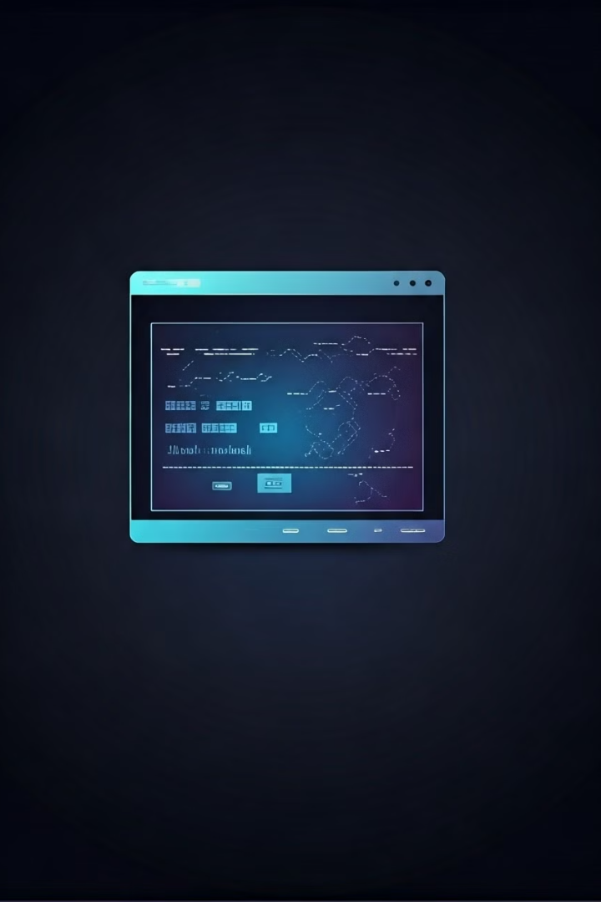




Example Use Case
Tester Input
A tester requests test data for a customer with an account balance exceeding $10,000 in the GAMS database.
AI Processing
The GPT AI model translates the natural language query into a SQL query and retrieves the desired data from the specified database.
Data Retrieval
The AI system retrieves the relevant test data automatically, eliminating the need for manual SQL queries.
Result Presentation
The retrieved test data is presented in a user-friendly format, allowing testers to analyze and use it effectively.

Slide 9

Risks
1
Data Security
Proper safeguards are crucial to protect sensitive data during the data mining process.
2
Model Inaccuracies
Model inaccuracies could lead to incorrect data retrieval, requiring robust validation mechanisms.
3
System Dependency
Reliance on AI systems introduces potential bottlenecks if the model encounters issues, necessitating backup plans.

